Slide 1
Discretized Streams: Fault-Tolerant Streaming Computation at Scale
Matei Zaharia, Tathagata Das, Haoyuan Li, Timothy Hunter, Scott Shenker, Ion Stoica
Presenter: Keyu Chen

Slide 2
Introduction
A social network may wish to detect trending conversation topics in minutes
A search site may wish to model which users visit a new page
A service operator may wish to monitor program logs to detect failures in seconds.

Slide 3
Two major problems – Faults and stragglers (slow nodes)
Replication - two copies of each node
Upstream backup - nodes buffer sent messages and replay them to a new copy of a failed node

Slide 4
Neither approach is attractive
Replication costs 2x hardware and upstream backup takes a long time to recover
Neither approach handles stragglers.

Slide 5
D-Streams – discretized streams
To structure a streaming computation as a series of stateless, deterministic batch computations on small time intervals.
We might place the data received every second into an interval, and run MapReduce operation on each interval to compute a count
We can run a rolling count over several intervals by adding the new count from each interval to the old result

Slide 6
D-Streams – discretized streams
The state at each time step fully deterministic given the input data, forgoing the need for synchronization protocols
The dependencies between this state and older data visible at a fine granularity.

Slide 7
D-Streams – Goals
Scalability to hundreds of nodes.
Minimal cost beyond base processing.
Second-scale latency.
Second-scale recovery from faults and stragglers.

Slide 8
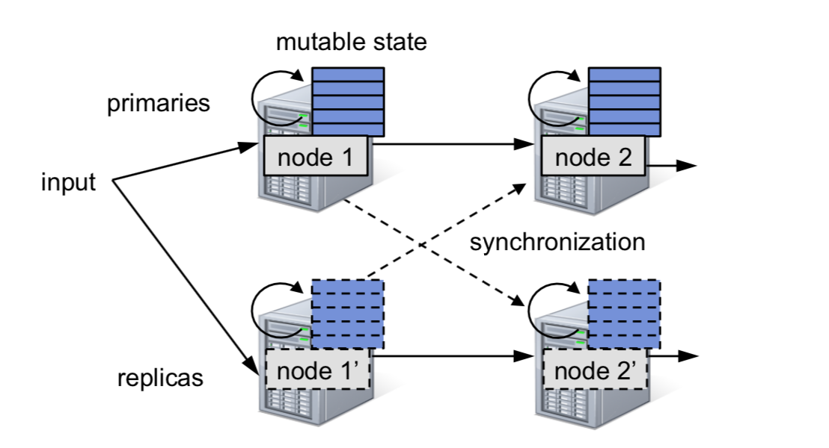
Previous Processing Models
Streaming computations are divided into long-lived state operators
Each operator processes records as they arrive by updating internal state and sending new records in response

Slide 9
Recovery Schemes- Replication
Two copies of the processing graph and input records are sent to both.
A synchronization protocol to ensure two copies see messages from parents in the same order.
Replication is costly, though it recovers from failures quickly.

Slide 10
Recovery Schemes- Upstream Backup
Each node retains a copy of the messages it sent since some checkpoint
When a node fails, a standby machine takes over its role, and parents reply messages to this standby
Incurs high recovery times, because a single node must re-compute the lost state by running data through serial operator

Slide 11
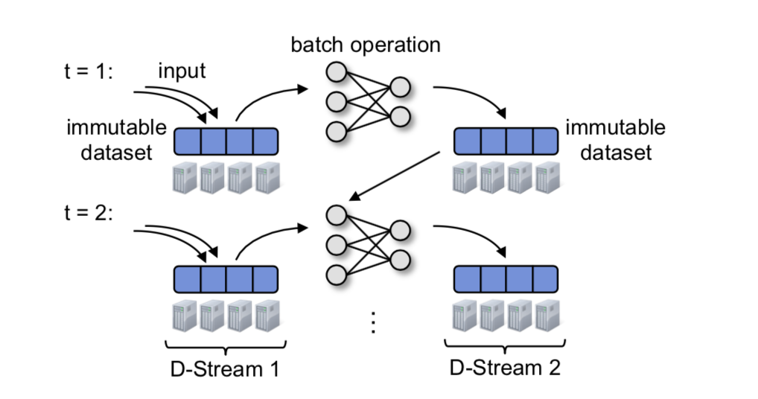
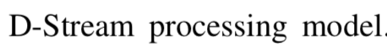
D-Streams processing model
In each time interval, the records that arrive are stored reliably across the cluster to form an immutable, partitioned dataset
Being processed via deterministic parallel operations to compute other distributed datasets
These datasets represent program output or state to pass to next interval

Slide 12
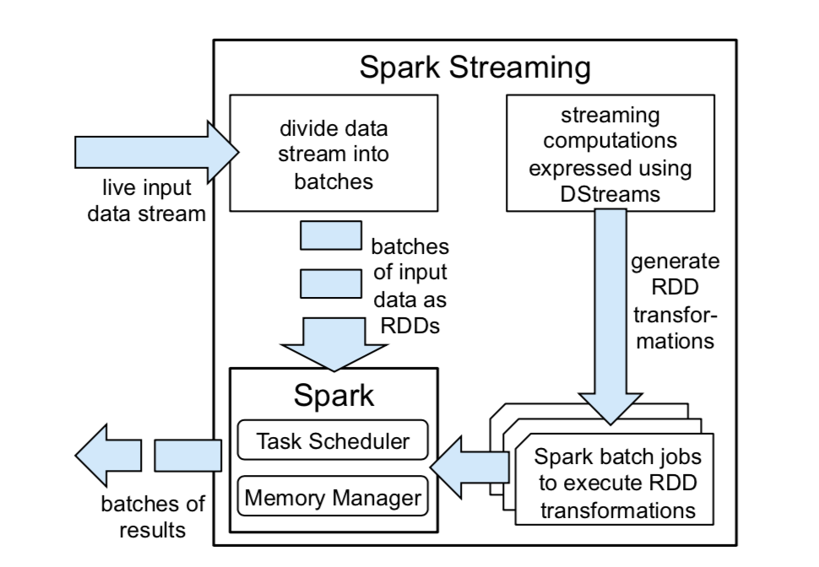
Batch processing engine
Divide the data stream into one second batches and store them as RDDs (resilient distributed datasets)
Invoke RDD transformations like map and reduce to process RDDs

Slide 13
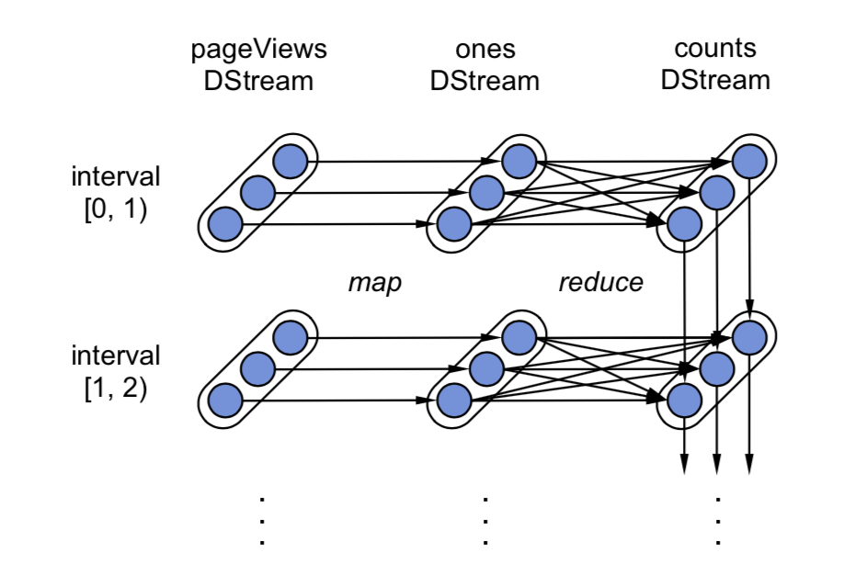
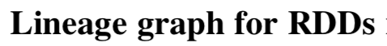
Recovery Schemes- Lineage
When a node fails, it re-computes the RDD partitions that were on it
Periodically checkpoints state RDDs to prevent infinite re-computation

Slide 14
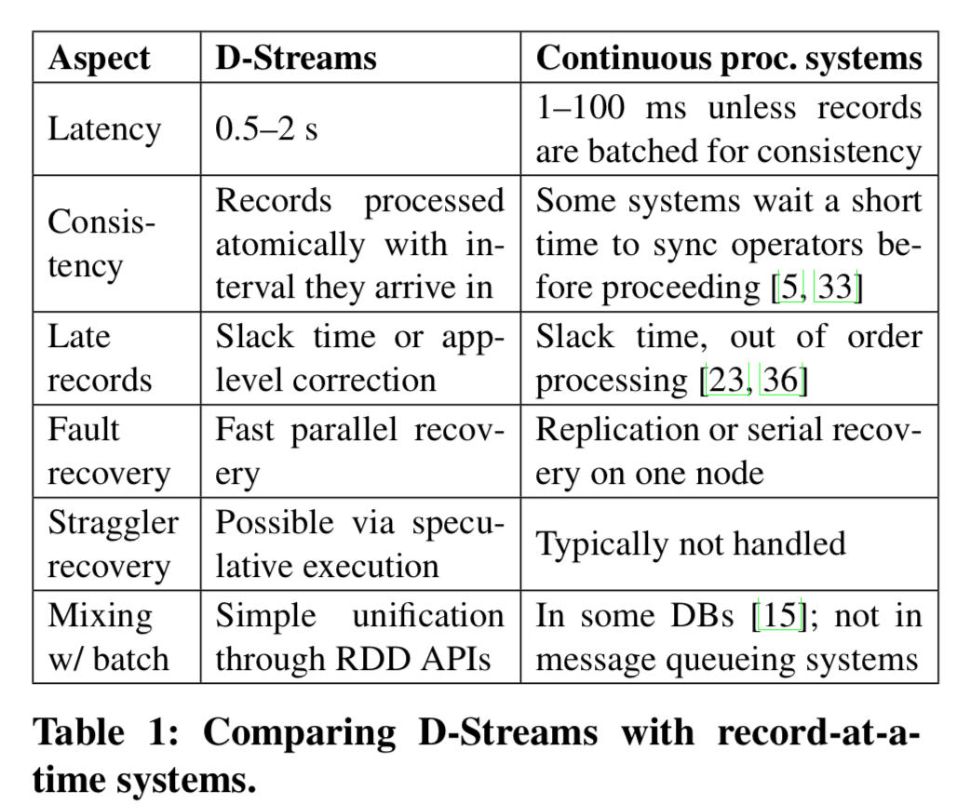
Compare D-Stream with Continuous
Continuous operator systems have smaller latency
D-Streams handles fault and straggler recovery better

Slide 15
Two powerful recovery techniques
Parallel Recovery
When a node fails, D-Streams allow the state RDD partitions to be recomputed in parallel on other nodes
The system periodically checkpoints some of the state RDDs, by synchronously replicating them to other worker nodes

Slide 16
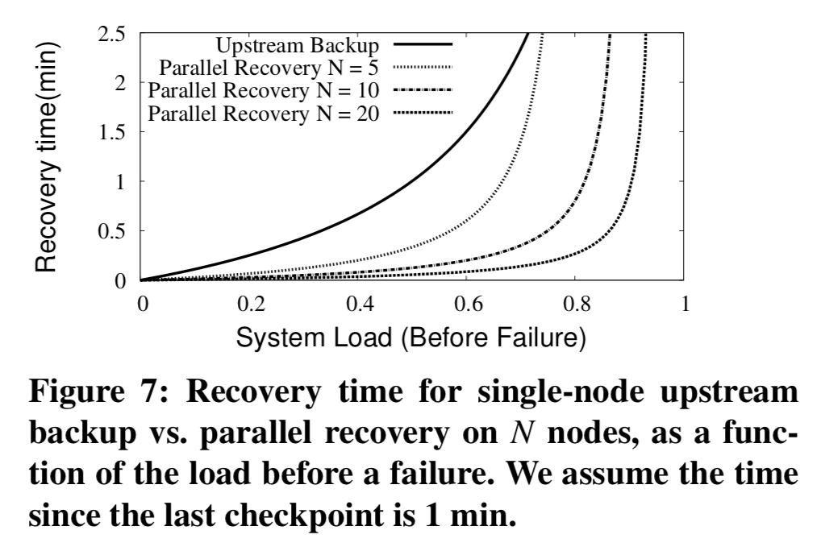
Two powerful recovery techniques
Parallel Recovery
It takes a long time to catch up at high loads because new records continue to arrive while it is rebuilding old state
With more nodes, parallel recovery catches up much faster than upstream backup

Slide 17
Two powerful recovery techniques
Straggler Mitigation
Run speculative backup copies of slow tasks like batch systems
Whenever a task runs more than 1.4x longer than the median task, we mark it as slow. We use this simple threshold to detect stragglers

Slide 18
Performance
Three applications
Grep: Find the number of input strings matching a pattern
Word-Count: Perform a sliding window count over 30s
TopKCount: Find the k most frequent words over past 30s

Slide 19
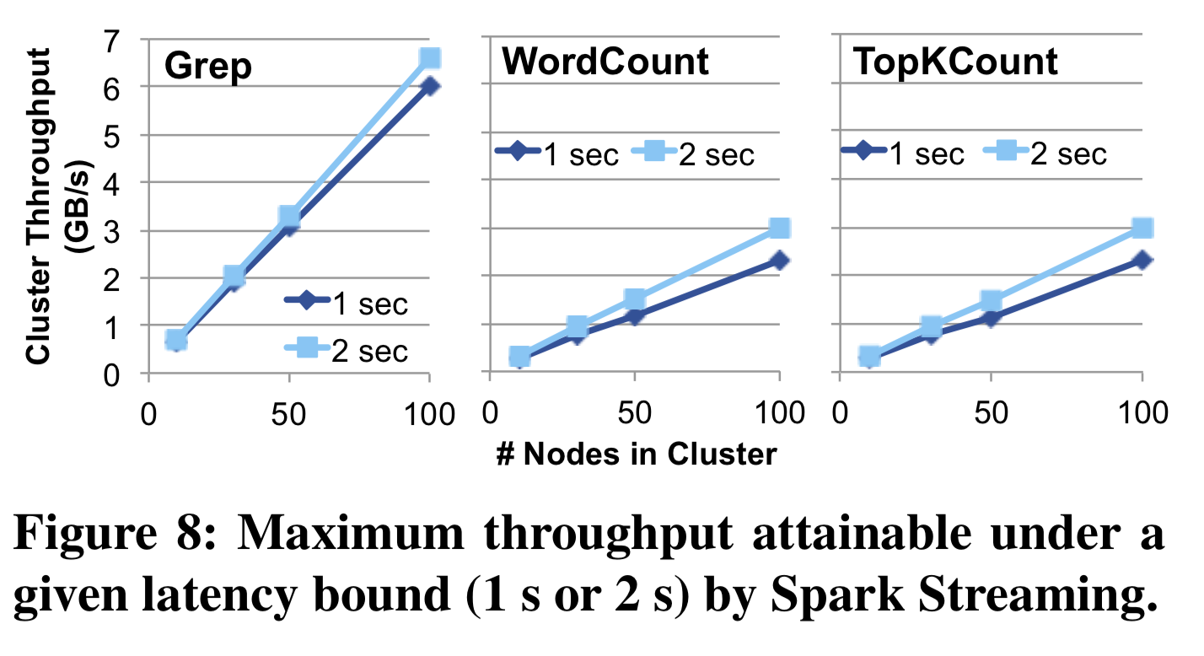
Performance
Scales nearly linearly to 100 nodes
Process up to 6 GB/s at 2s latency for Grep, or 2.3 GB/s for the other more CPU-intensive jobs
Allowing a larger latency improves throughput slightly.

Slide 20
Performance
Comparison with Commercial Systems
Spark Streaming’ s per-node throughput of 64M records/s for Grep and 25M records/s for TopKCount is comparable to the speed for commercial systems
Key advantage is Spark Streaming scales nearly linearly to 100 nodes

Slide 21
Performance
Comparison with open source distributed streaming systems
S4 – Yahoo streaming systems
At most 7500 records/s for Grep and 1000 for WordCount, which made it almost 10x slower than Spark and Storm
Do not offer consistency across nodes and have limited fault tolerance guarantees because it’s continuous operators systems

Slide 22
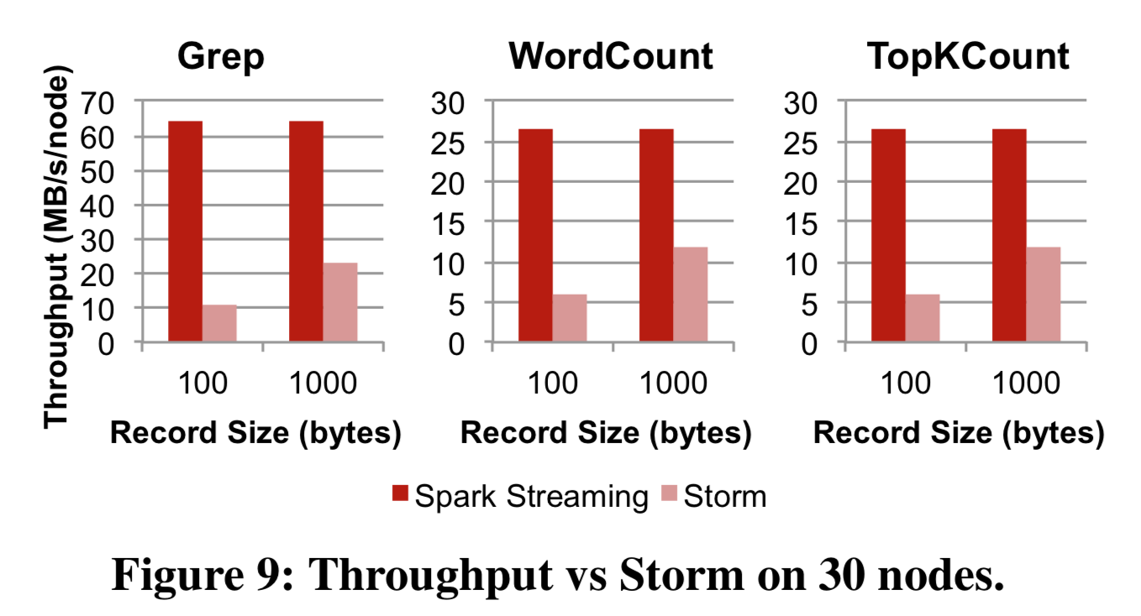
Storm – Twitter streaming systems
Storm is adversely affected by smaller record size
Storm is faster with 1000-byte records, but still 2x slower than Spark

Slide 23
Fault and Straggler Recovery
Recovery time
Varying the checkpoint interval
Varying the number of nodes

Slide 24
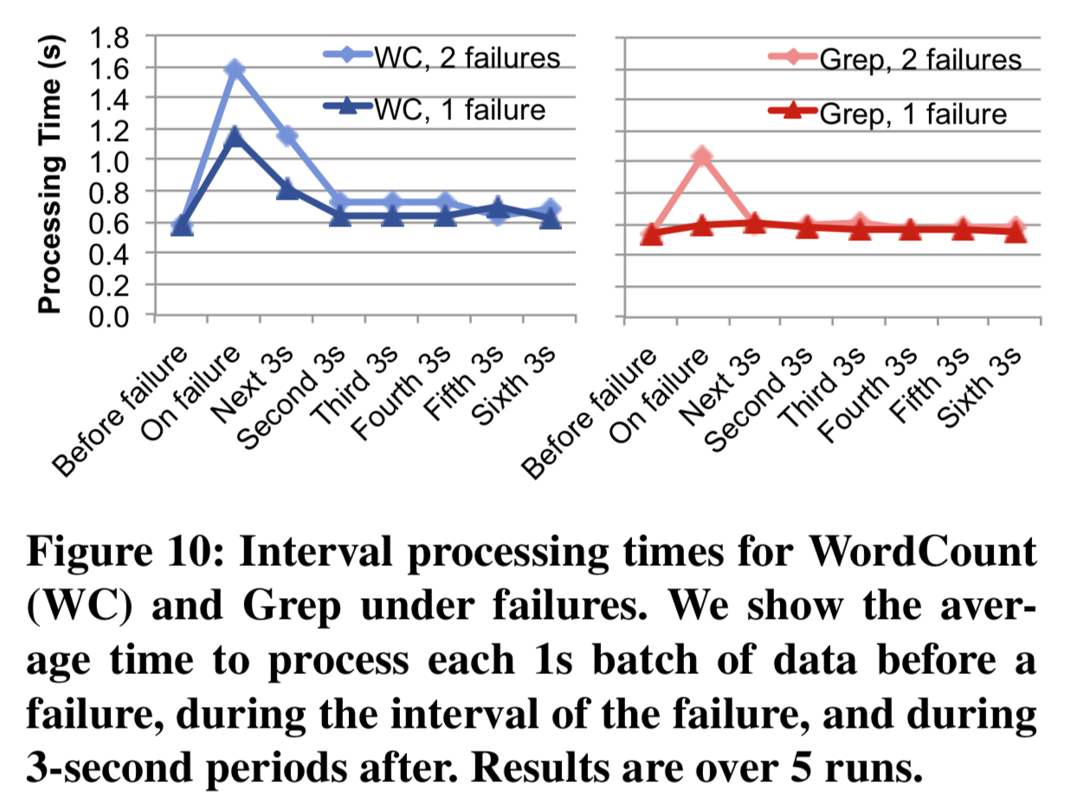
Recovery Time
Recovery is fast, with delays of at most 1 second even for two failures and a 10s checkpoint interval
WordCount’s recovery time is longer because it has to recompute data going far back, but Grep just loses four tasks on each failed node

Slide 25
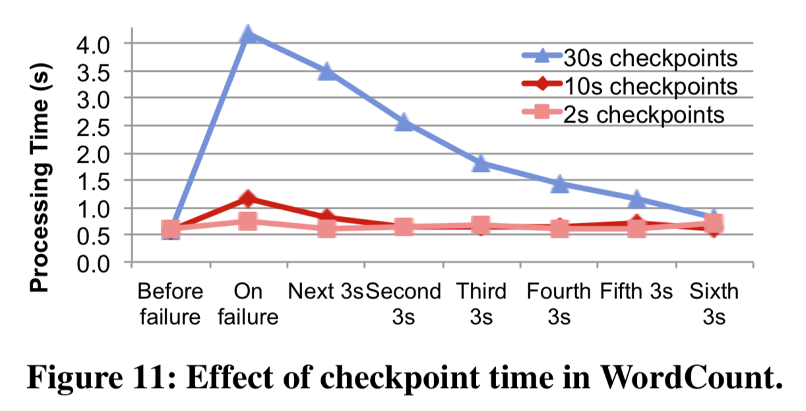
Varying the checkpoint interval
Even when checkpointing every 30s, results are delayed at most 3.5s
With 2s checkpoints, the system recovers in just 0.15s

Slide 26
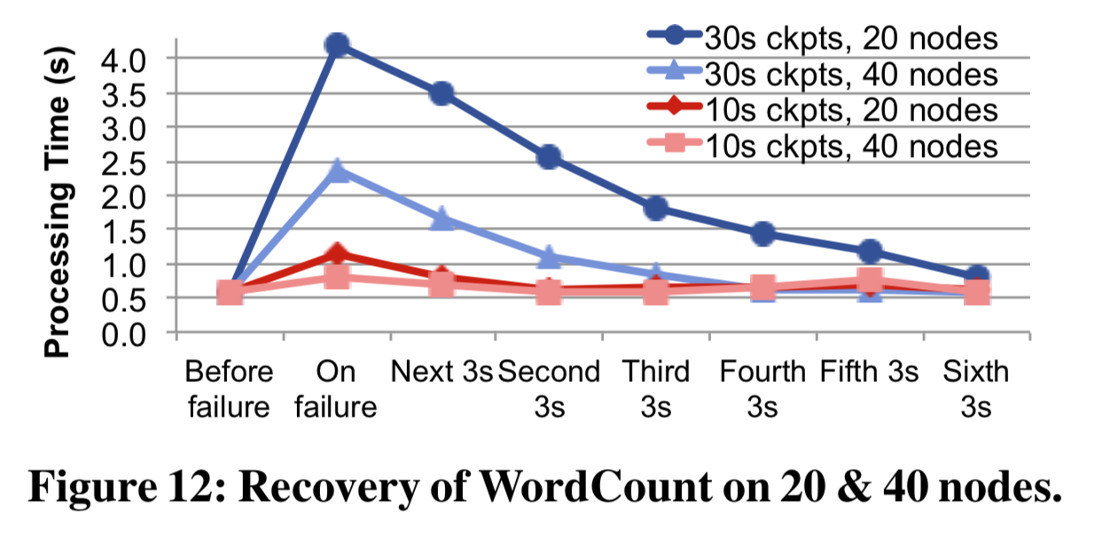
Varying the number of nodes
Doubling the nodes reduces the recovery time in half

Slide 27
Fault and Straggler Recovery
Straggler Mitigation

Slide 28
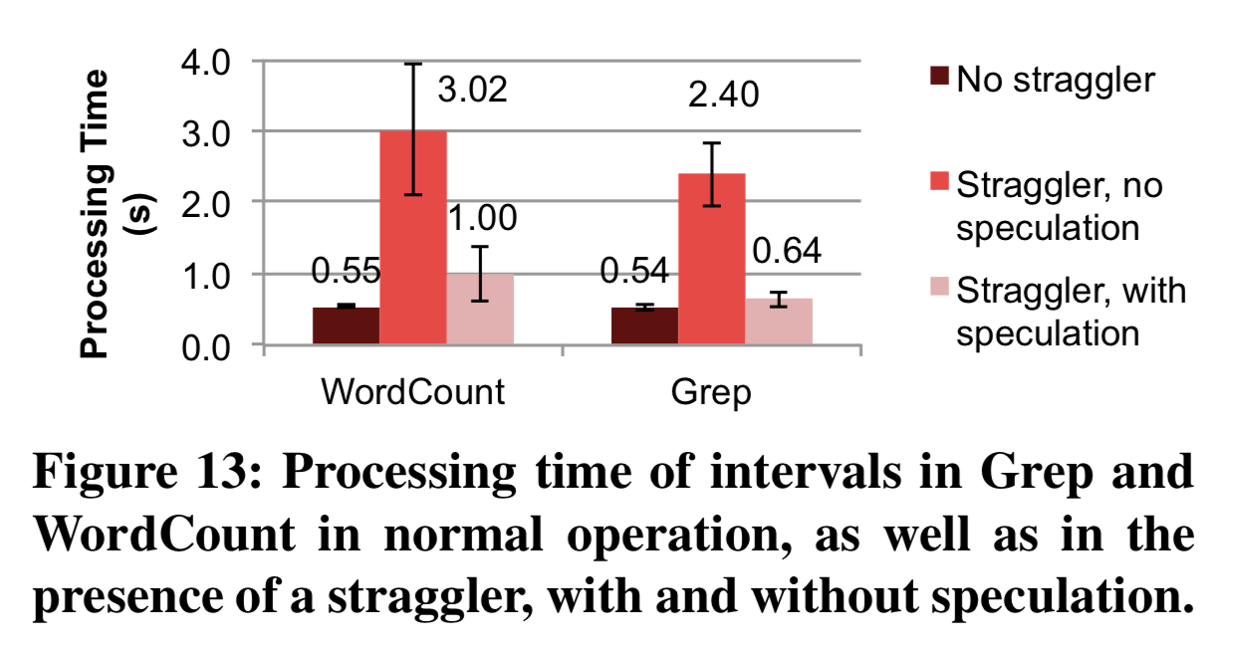
Straggler Mitigation
Speculation improves the response time significantly

Slide 29
Real Applications
Video Distribution Monitoring
Crowdsourced Traffic Estimation

Slide 30
Real Applications
Video Distribution Monitoring
Conviva is a platform the has the ability to track the performance across different geographic regions, CDNs and ISPs, which allows the broadcasters to quickly identify and respond to delivery problems
The system receives events from video players and uses them to compute more than fifty metrics, including complex metrics such as unique viewers and session-level metrics

Slide 31
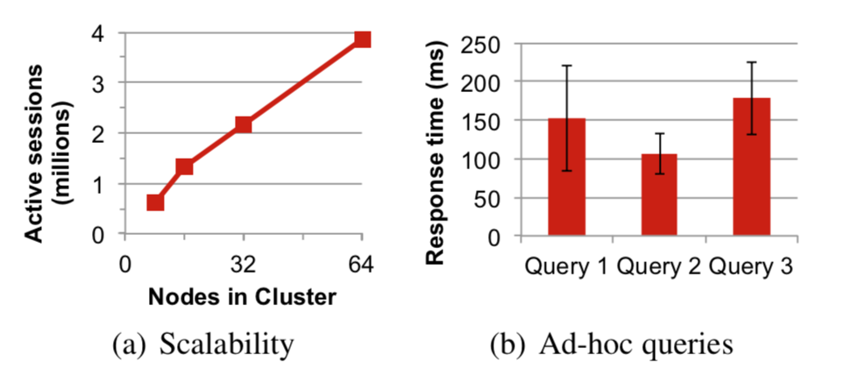
Video Distribution Monitoring
D-Stream could process enough events to support 3.8 million concurrent viewers
Spark Streaming can run ad-hoc queries from a Scala shell in less than a second on the RDDs

Slide 32
Real Applications
Crowdsourced Traffic Estimation
Apply D-Stream to the Mobile Millennium traffic information system, a machine learning based project to estimate automobile traffic conditions in cities
While measuring traffic for highways is easy due to dedicated sensors, arterial roads lack such infrastructure
Mobile Millennium solves this problem by using crowdsourced GPS data from fleets of taxi and cellphones

Slide 33
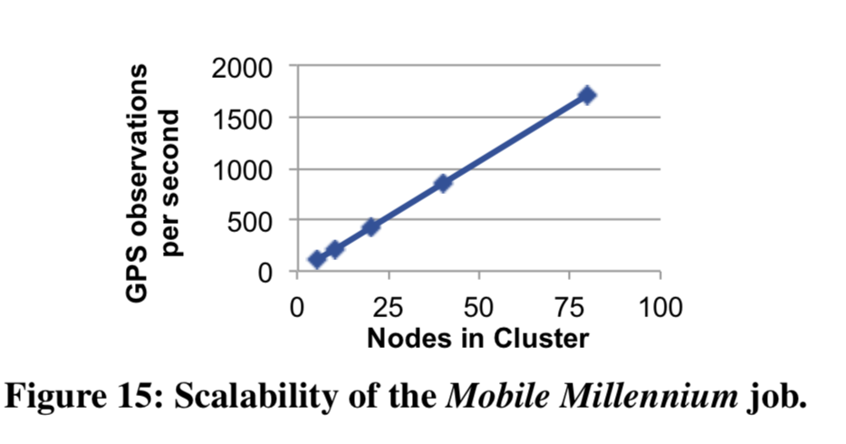
Crowdsourced Traffic Estimation
Porting this application to Spark Streaming using an online version of the EM algorithm
The algorithm scales nearly perfectly because it’s CPU-bound, and provides answers 10x faster than batch version

Slide 34
Discussion
D-Stream is a new stream processing model for clusters. By breaking computations into short, deterministic tasks and storing state in lineage-based data structures (RDDs). D-Streams can use powerful recovery mechanisms to handle faults and stragglers.

Slide 35
Discussion
Benefits:
Beyond the recovery benefits, the most important aspect of D-Stream is that they show that streaming, batch and interactive computations can be unified in the same platform.
This enables rich features like combining streams with offline data or running ad-hoc queries on stream state.

Slide 36
Discussion
Limitation:
They have a fixed minimum latency due to batching data. The total delay can still be as low as 1-2 seconds, which is enough for many real-world use cases.

Slide 37
Discussion
Future Work:
Expressiveness
Setting the batch interval
Memory usage
Approximate results

Slide 38
Discussion
Expressiveness:
As D-stream is primarily an execution strategy, it should be possible to port languages like streaming SQL or Complex Event Processing models over them

Slide 39
Discussion
Setting the batch interval:
Currently, a developer has to explore the trade-off and determine the batch interval manually. It may be possible for the system to tune it automatically

Slide 40
Discussion
Memory usage:
This model generates a new RDD to store each operator’s state after each batch of data is processed, which will incur a higher memory usage than continuous operators with mutable state
It may be possible to reduce the memory usage by storing only the deltas between these state RDDs

Slide 41
Discussion
Approximate results:
In addition to re-computing lost work, another way to handle a failure is to return approximate partial results. D-stream provide the opportunity to compute partial results by simply launching a task before its parents are all done.

Slide 42
Drizzle: Fast and Adaptable Stream Processing at Scale
Shivaram Venkataraman* UC Berkeley, Michael Armbrust Databricks, Aurojit Panda UC Berkeley,
Ali Ghodsi Databricks, UC Berkeley Kay Ousterhout UC Berkeley, Michael J. Franklin University of Chicago
Presenter: Che Yu Lin

Slide 43
Background
Large scale stream processing
Run mission-critical applications, and must be available 24x7. Thus such systems need to adapt to failures and inherent changes in workloads, with minimal impact on latency and throughput.
Case study: Video Quality Prediction
The prediction service is run as a streaming application that computes a number of aggregates based on heartbeats from clients and then queries a machine learning model to determine the optimal parameters for bitrate, CDN location, etc.
Desired Properties
High Throughput, Low latency, Adaptability, Consistency
Notes:
Recent trends in data analytics indicate the widespread adoption of stream processing workloads that require low-latency and high-throughput execution. Examples of such workloads include real time object recognition and internet quality of experience prediction. Systems designed for stream processing often process millions of events per second per machine and aim to provide sub-second processing latencies. Stream processing systems are deployed to process data 24x7, and therefore in addition to meeting performance requirements, these systems must also be able to handle changes in the cluster, workload or incoming data. This requires that they gracefully react to software, machine or disk failures, that can happen once every few hours in large clusters or straggler tasks.
bla bla bla The output from the streaming job needs to be computed approximately every 100ms to reflect the most recent state of the network to the video frontends. Further the number of heartbeats can range in thousands to millions of updates per second. If the system cannot meet the 100ms deadline (either due to failures or other changes), the use of stale prediction results can lead to a user perceivable degradation in service due to say a wrong choice of bitrate. As a result the prediction service must ensure that it can rapidly recover from failures, and minimize violations of the target latency.
Besides high throughput and low latency that we care about performance, users also care about other aspects of stream processing systems. So one of the most important things when you're running on such a large cluster is in terms of the system being more adaptable. So what do I mean by adaptability. So one, for example, fault tolerance, where machines could fail, some of the slow machines could make you slow down your job, these are the examples where you want the system to be adaptable, and handle such events seamlessly. But it's not just in terms of fault tolerance. adaptability also applies to scenarios where you want to improve the performance of the system. So for example, elasticity, right, let's say we add a bunch of machines for the cluster is an example of any, we'd like our system to adapt to the changes in the cluster, and improve performance. Consistency is also an important desired properties as it is the main challenge in distributed stream processing is ensuring consistency for results produced over time.
High Throughput. There has been a rapid increase in the amount of data being generated and collected for analysis, and high-throughput processing is essential to keeping up with data streams. For example, in a recent blog post [23] LinkedIn reported generating over 1 trillion messages per day using Kafka, similarly Twitter [58] reports that their time series databases need to handle 2.8 billion writes per minute. Keeping up with these ingest rates requires using distributed stream processing systems whose throughput matches or exceeds the incoming data rate.
Low Latency. We define the latency of a stream processing system as the time that elapses between receiving a new record and producing output that accounts for this record. For example, in an anomaly detection workload which predicts trends [2] using a 1-second tumbling window, the processing latency is the time taken to process all events in a one second window and produce the necessary output. Processing latency impacts the system’s responsiveness and high latency can both limit the applications that can be supported by a system and user perceived responsiveness. As a result, distributed streaming systems need to provide low latency, and should be designed to ensure that latencies remain low even when the system is scaled across machines.
Adaptability. Unlike traditional analytic queries, streaming jobs process live data and are long lived. As a result the system needs to be able to adapt to changes in both workload and cluster properties. For example, recent papers from Twitter [26, 41] observe that failing hardware, load changes or misbehaving user code occur frequently in production clusters. Additionally it is important to ensure that adaptation does not lead to correctness or prolonged latency spikes [46].
Consistency. A main challenge in distributed stream processing is ensuring consistency for results produced over time. Consistency could be defined in terms of application-level semantics or lower-level message delivery semantics. For example if we have two counters, one tracking the number of requests and another tracking the number of responses, it is important to ensure that requests are accounted for before responses. This can be achieved by guaranteeing prefix integrity, where every output produced is equivalent to processing a well-specified prefix of the input stream. Additionally, lower-level message delivery semantics like exactly once delivery are useful for programmers implementing fault tolerant streaming applications. In this work we aim to maintain the consistency semantics offered by existing systems and focus on performance and adaptability.

Slide 44
Continuous Operator Streaming
In this model, user programs are converted to a DAG of operators, and each operator is placed on a processor as a long running task. As data is processed, operators update local state and messages are directly transferred from between operators.
Checkpoint can handle machine failures, but performing a checkpoint replay is expensive.
Recovery of the continuous operator is done in serial.
Ex. Apache Flint, Naiad
Notes:
So given that these are our goals, how do we go about achieving them. And to do this, if we look at the history of streaming process systems. There are two main sort of execution models that are being used by systems capable at that time. One of the most classic execution model is Continuous Operator Streaming. bla bla bla You can simply think of it as in this case what happens is, at the beginning of time, we have a centralized driver or a scheduler that goes ahead and launches a number of these operators that are going to run on various machines. Now these operators. Start, and then read data from the input sources, and they also exchange messages with each other in order to make progress along over the course of time. The characteristics of this model are that we have these long lived operators that live on every machine in the cluster. And then we have some mutable state and each of these operators, which is making sure that it's updating whatever is the intermediate data that is getting processed.It take distributed checkpoints for fault tolerant and failure recovery. However, performing the checkpoint replay is expensive.

Slide 45
Computation Models for Streaming
Bulk-synchronous parallel (BSP) for Streaming System.
In this model, the computation consists of a phase whereby all parallel nodes in the system perform some local computation, followed by a blocking barrier that enables all nodes to communicate with each other, after which the process repeats itself.
The computation is a directed acyclic graph (DAG) of operators and is partitioned into different stages with a barrier between each of them.
Ex. MapReduce (map, reduce); Spark (filter, sum, groupby, join)
Notes:
Now, in contrast to the previous model, there's a second model, which is the Bulk-synchronous parallel (BSP) for Streaming System (or batch processing model). So in this model, what happens is that we have as similarly as central driver that launches some tasks on these machines. But in contrast, the previous case, these tasks actually coordinate with decentralized driver as soon as they finish execution of whatever quantum of work that they give it. Now, in order to exchange data between different stages. This is shuffle operation that is coordinated again by the centralized driver. And this allows a centralized server to make some clever placement choices on where these tests are placed. Now, the key characteristics of this model are that we have centralized task annealing, which is shown in these red boxes out here. And because we have the centralized task handling, we can actually do more intelligent things for fault tolerance, which are like lineage, and paddle recovery, and so on. And finally, the scheduler, the driver can also provide other forms of adaptability like to adjust to new machines being added to the cluster, or the new straggler mitigation. And so this model, as I said before, is definitely used in Spark.

Slide 46
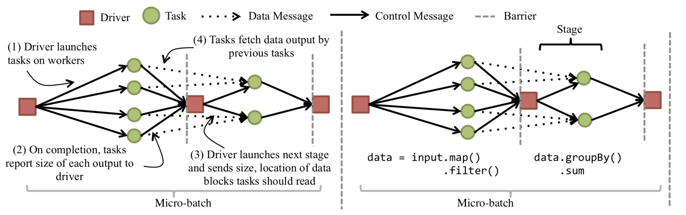
Batch processing model for Streaming Jobs

Slide 47
Micro-batch
Streaming is implemented by creating a micro batch of duration of T seconds. During the micro-batch, data is collected from the streaming source, processed through the entire DAG of operators and is followed by a barrier that outputs all the data to the streaming sink.
Due to its implementation, T cannot be set to adequately small values. In most system, T is limited to 0.5 seconds or more.
Fault tolerance and failure recovery is rather easy.
Spark streaming, FlumeJava

Slide 48
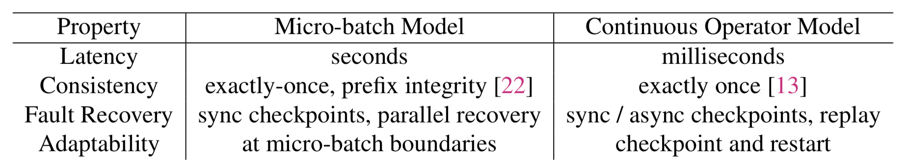
Comparing Computation Model
Notes:
So just to put them back together on two planes. On one hand, we have the model, which lets us use lineage for partial results and having these micro batch boundaries where we can do some optimization, but suffers from more high latency when compared to the continuous operator model. On the other hand, the continuous operator model provides much lower latency but have more complex mechanisms for fault tolerance and we find it difficult to do things like elasticity and straggler mitigation.
So the main question now becomes. Can we actually achieve low latency like these systems are achieving with some design like Spark. Or to put it another way, can we unify both the advantages of these models and sort of get the best of both low latency and adaptability.
Exactly once: For each received record, its processed results will be reflected once, even under failures.
Prefix Integrity: At any time, the output of the application is equivalent to executing a batch job on a prefix of the data.

Slide 49
Drizzle
A system that decouples the processing interval from the coordination interval used for fault tolerance and adaptability.
Fine-grained execution of data processing
Coarse-grained scheduling of coordination
Notes:
Here the paper presents Drizzle. And the main insight here is that they split execution at different granularity. Or to put it another way, they do data processing at a very fine granularity in order to achieve low latency. But they took coordination at a more coarse granularity in order to reduce overhead. So this is the main idea behind it.

Slide 50
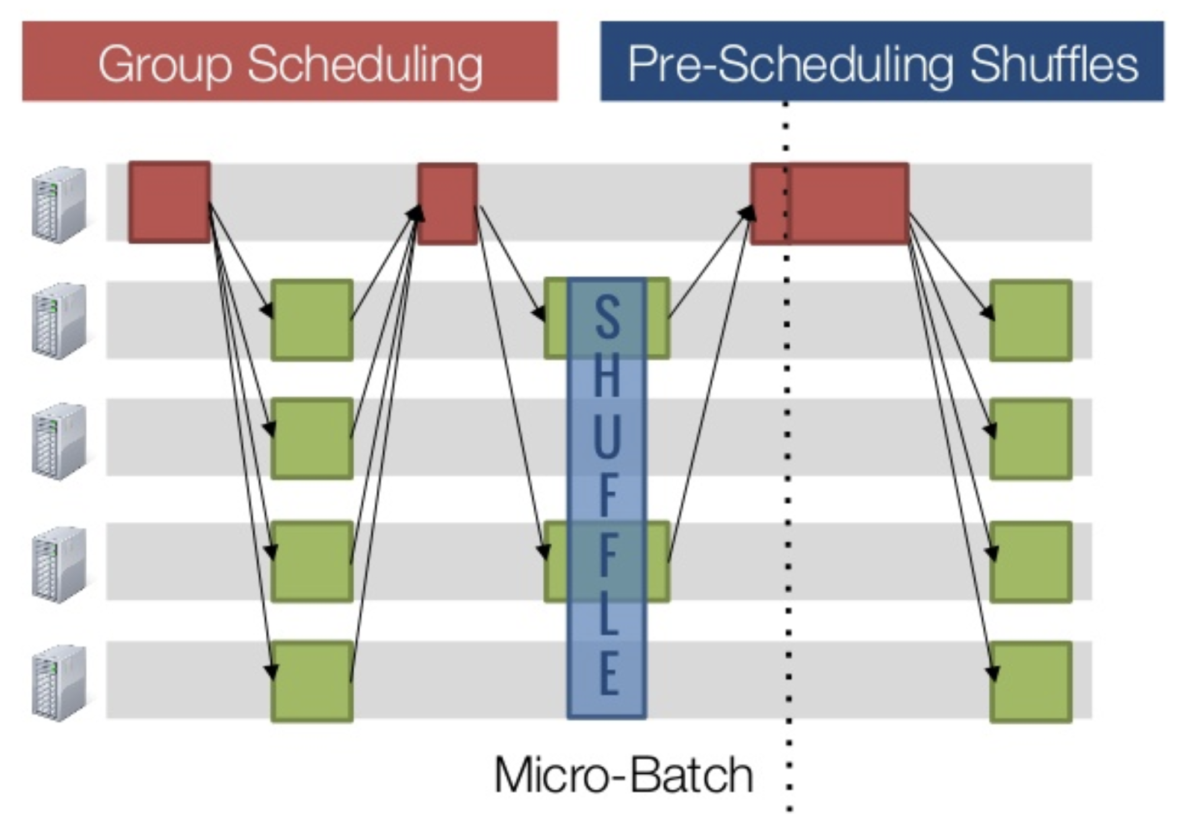
Drizzle
https://www.slideshare.net/SparkSummit/drizzlelow-latency-execution-for-apache-spark-spark-summit-east-talk-by-shivaram-venkataraman
Notes:
And there are two main techniques in Drizzle. Group scheduling and pre-scheduling. And I'll walk over at a high level how these techniques work. And then give some of the evaluations on how these techniques actually help in practice

Slide 51
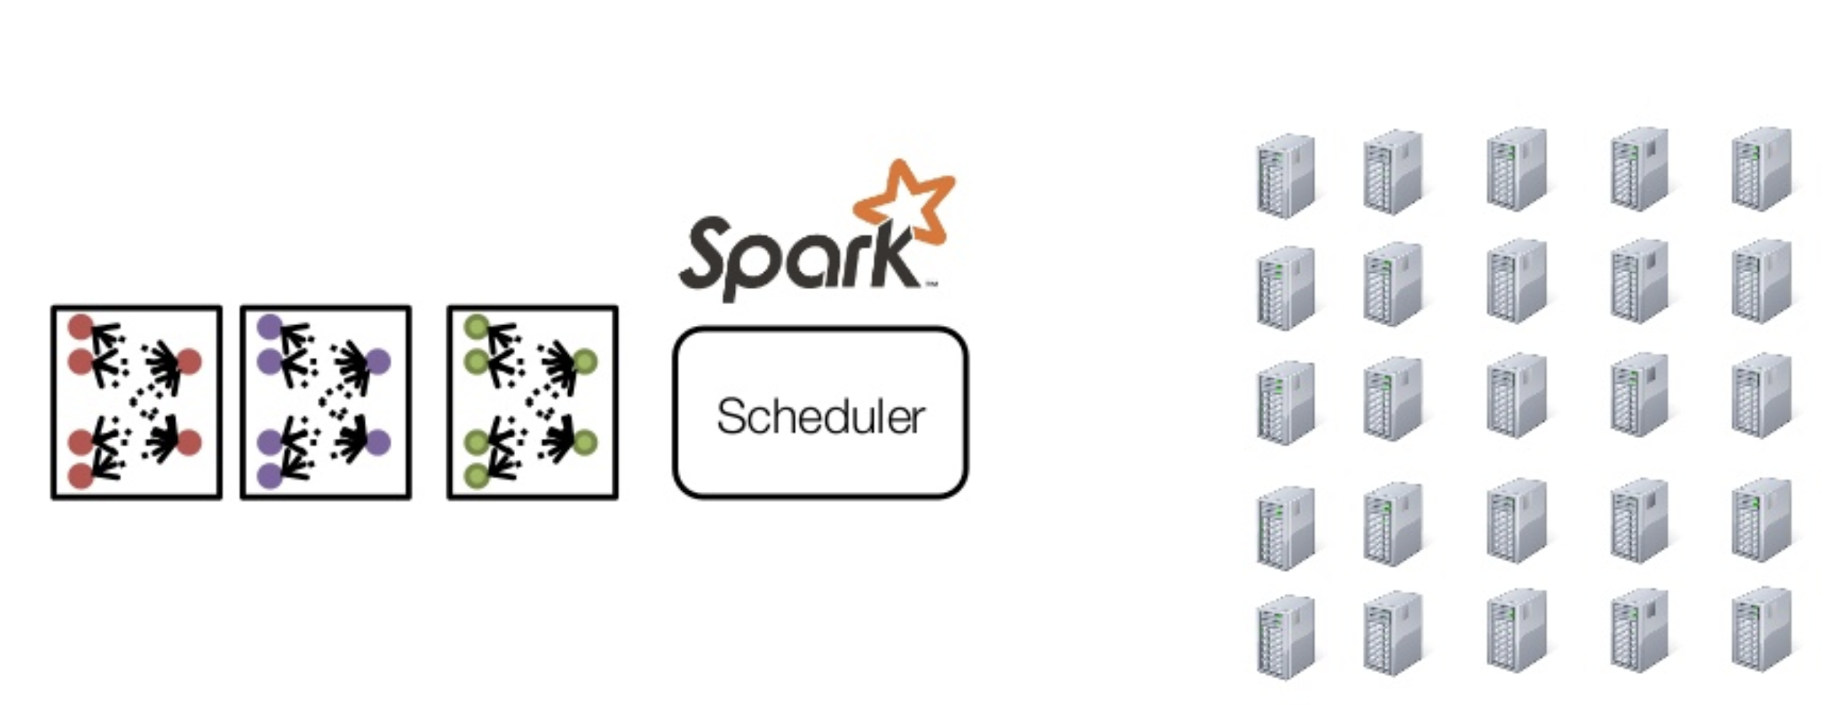
Spark Streaming
Notes:
So let's start with group scheduling. And before we take a look at scheduling. Let’s first dig into how Spark streaming works. So we have this scheduler mentioned before, that takes many submitted micro-batch inputs. It manages to place them on running machines. As soon as the first one is finish, the second one is placed, and the third one, and so on. Now, in order to understand how the scheduling works, let's zoom in a little bit more into the heart of the scheduling system that is presented Spark.

Slide 52
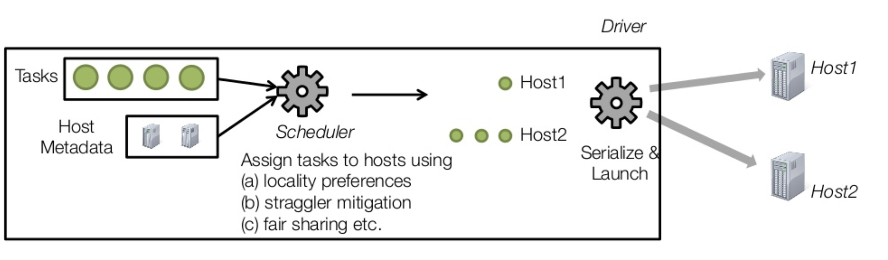
Dag Scheduling
Notes:
So at a very high level, what the scheduler is doing is that it's trying to find out where each task you submitted, should be placed. And to do this, there are two main data structures, there's a list of tasks that need to get scheduled. And then there is a list of machines on how many cores that are there on each machine. And the scheduler runs number of algorithms, given these two data structures, and consider something like locality preferences, straggler mitigation, and fair sharing. And the output of these algorithms is a mapping from the host name to list of tasks that will run on that hostname. Once they have this mapping, we can then serialized and launch these tasks to run on the appropriate machines out there.

Slide 53
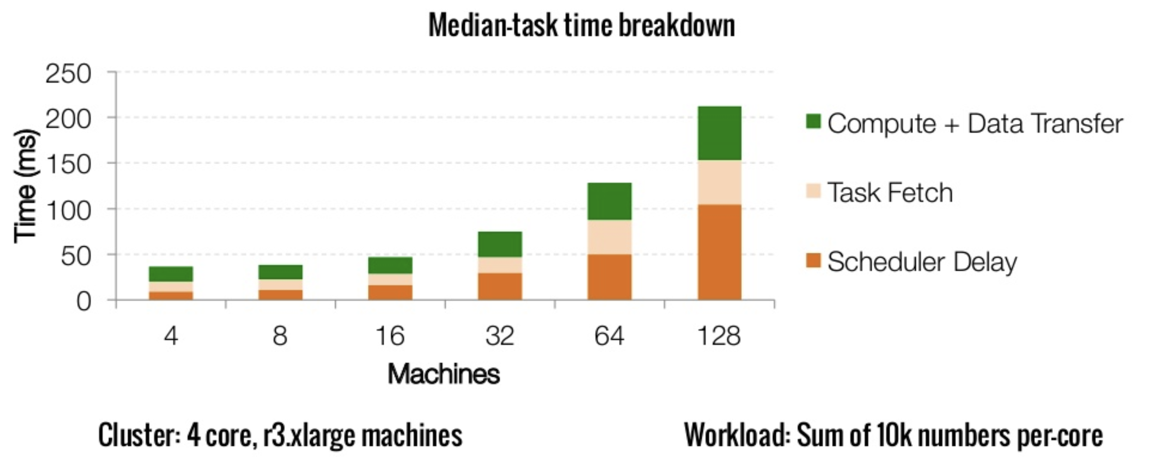
Scaling Batch Computation
https://www.slideshare.net/SparkSummit/drizzlelow-latency-execution-for-apache-spark-spark-summit-east-talk-by-shivaram-venkataraman
Notes:
So how expensive is it to do this kind of scheduling, especially when we have very low latency tasks that we are running. To measure this, they run a simple micro benchmark, and the micro benchmark computing on each task was something very simple, is to compute the sum of a bunch of random numbers. And the main idea behind the figure is to address the scheduling system to see how long it takes to do the scheduling. So the orange bars here represent the scheduling overhead, or the coordination overhead imposed by the system, while the green bar is like the use amount of work done. So you can see that when we have a smaller cluster, let's say, four to 16 machines, the balance is quite reasonable. It's like 25 to 30% of the overall execution. But when you go to like 128 machines, we find that about 70% of the time is taken up just by these overheads. And there's only 30% of use on some computation. Or to put it another way, it's almost impossible to run thing that is less than, like, 150 milliseconds for like, one of these jobs. And as you can imagine this gets worse if cluster is used as 1000 machines and so on.

Slide 54
Dag Scheduling
Same DAG structure for many iterations.
Can reuse scheduling decision.
Notes:
So the main idea behind Drizzle is that the DAG structure that we see across a number of these iterations, they actually remain the same. That's, for example, let's say we have the first micro batch and then the second micro batch, that's the structure of the job that is scheduling, it remains constant across about these micro batches and tasks, we can reuse the scheduling decision. For these expensive algorithms or the network communication. We don't need to repeatedly do that over and over again. So from this simple insight of group scheduling was born.

Slide 55
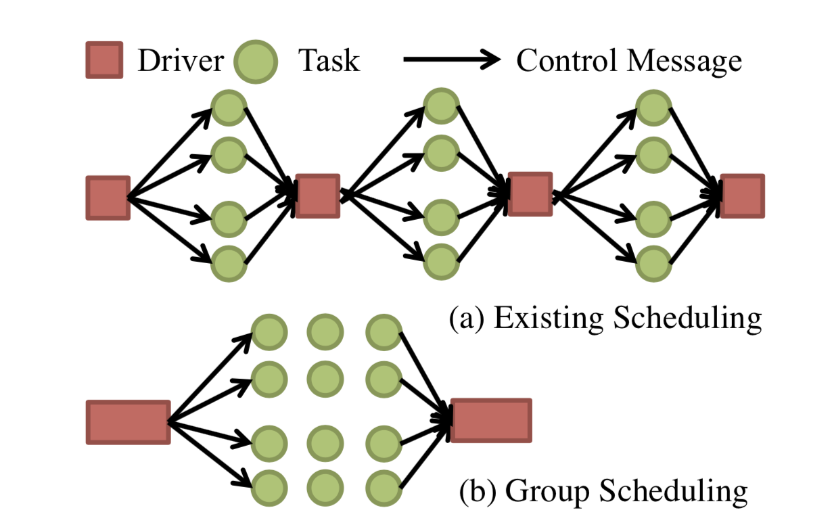
Group Scheduling
Schedule a group of iterations
at once.
Fault tolerance and scheduling
at group boundaries.
Notes:
And the idea here is that instead of scheduling one of these iterations one at a time, let's schedule a group of them at a time. So what that means is that, let's assuming we have one stage, and each iteration, our original execution looks something like this. And if we use grouping , we will make it look something like what is shown at the bottom of the slide where we have only one group of iterations that are being scheduled. Now, the trade off here is that the fault tolerance and scheduling now is at these group boundaries instead of these micro batch boundaries.

Slide 56
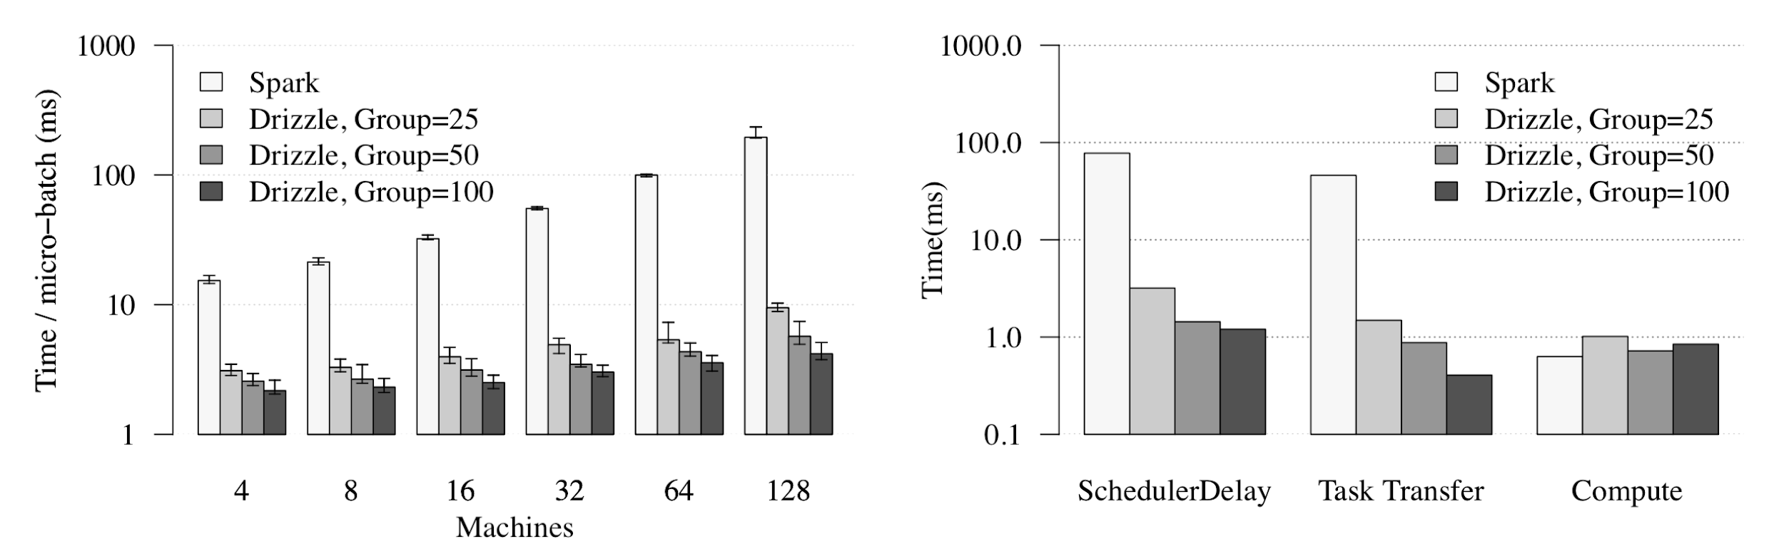
How much does this help?
Notes:
So how much does this help. They redid the same benchmark that is showed before, where we were computing the sum of random numbers. And the left-most bars here show how Apache Spark works, where the latency goes around 200 milliseconds at 128 machines. Now, in Drizzle, we can actually vary the group size. So the first thing is, when the group size to be 10. And that brings it down to around 21 milliseconds at 128 machine. But if we push it even further, let's say group size, of 50, or a hundred, we can run around five milliseconds of overall execution, at 128 machines. So as you can see from the figure, this has a tremendous impact from just like doing this simple idea that we are grouping a bunch of these iterations together.

Slide 57
Drizzle
https://www.slideshare.net/SparkSummit/drizzlelow-latency-execution-for-apache-spark-spark-summit-east-talk-by-shivaram-venkataraman
Notes:
After talking about the group scheduling, what happens to the shuffle operator there, that is also coordinate by the scheduler. So in order to address that they use this technique called pre-scheduling shuffle. And the idea here is really simple. So I'll first walk into how the existing shuffle implementations part works, and then show how we can actually get the scheduler out of the way when we are doing the shuffle.

Slide 58
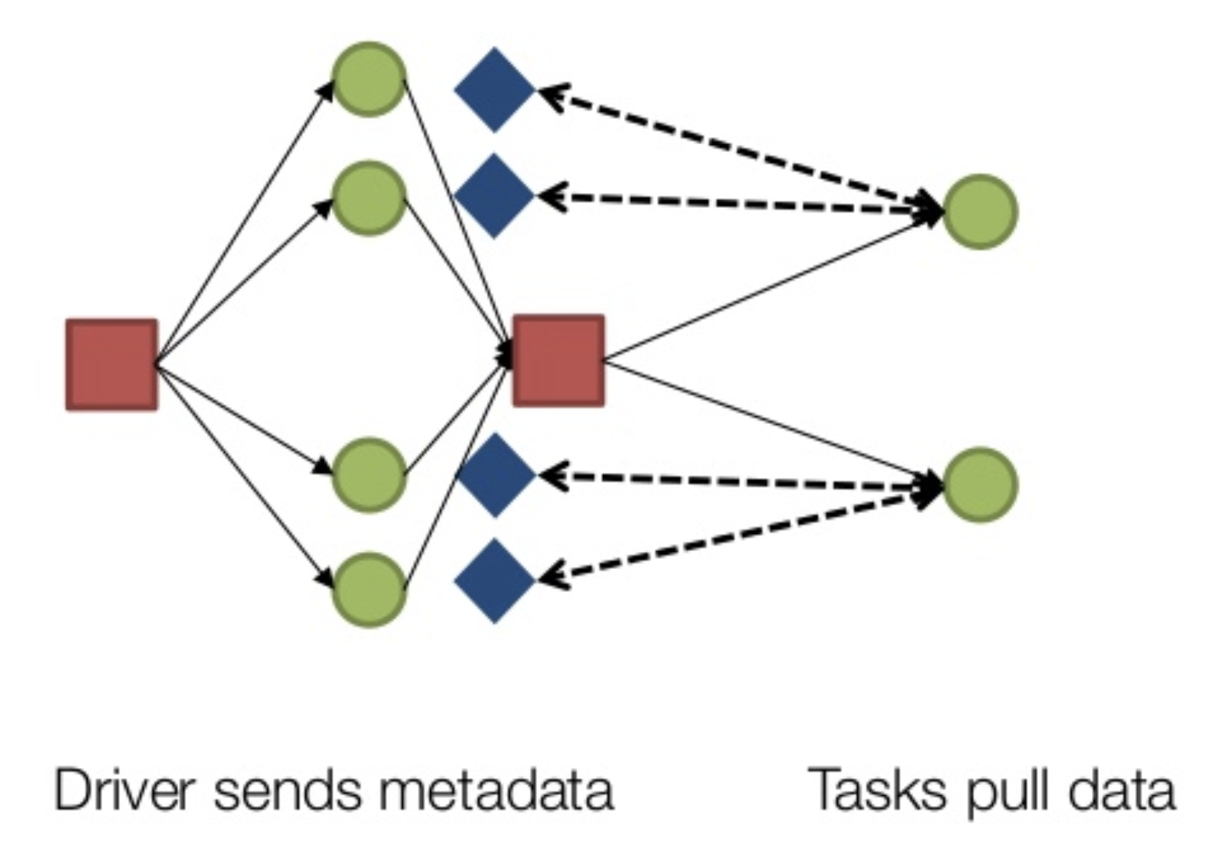
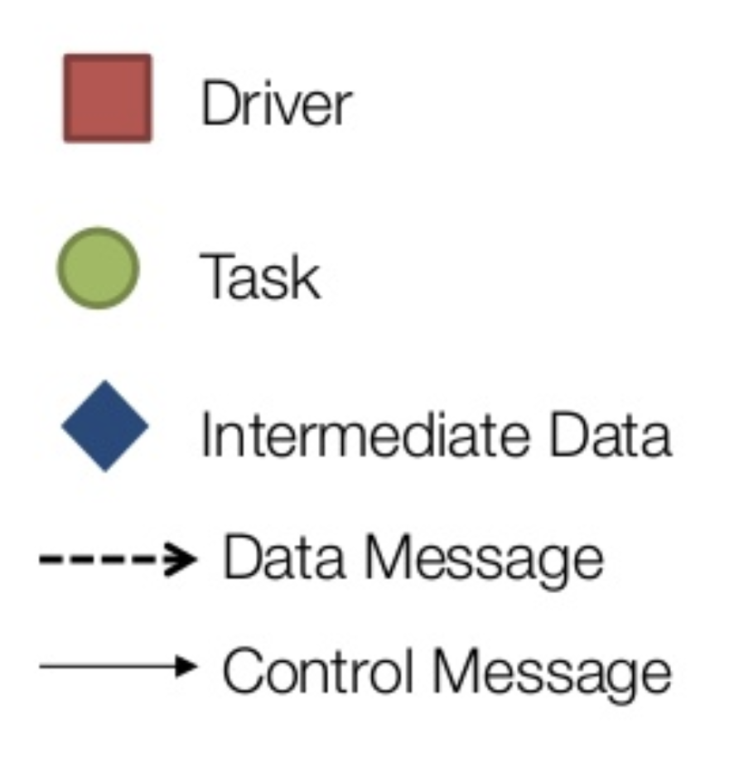
Shuffle Operation in Existing Systems
https://www.slideshare.net/SparkSummit/drizzlelow-latency-execution-for-apache-spark-spark-summit-east-talk-by-shivaram-venkataraman
Notes:
So in existing Spark, what happens is that we first launched these map stage tasks that is shown in green out here. And then they produce some output, which is this intermediate data shown in these blue boxes. Now, after this map phase finishes, we do some coordination. And then the driver launches these reduce tasks that are going to actually process the map outputs. Now, as a part of launching the reduced tasks, the scheduler also encodes where this data needs to be fetched from and then the data transfer happens over the network. So at a high level, the main characteristics of this existing architecture is that the driver sends the metadata, and then the tasks fetch data in order to complete the transfer.

Slide 59
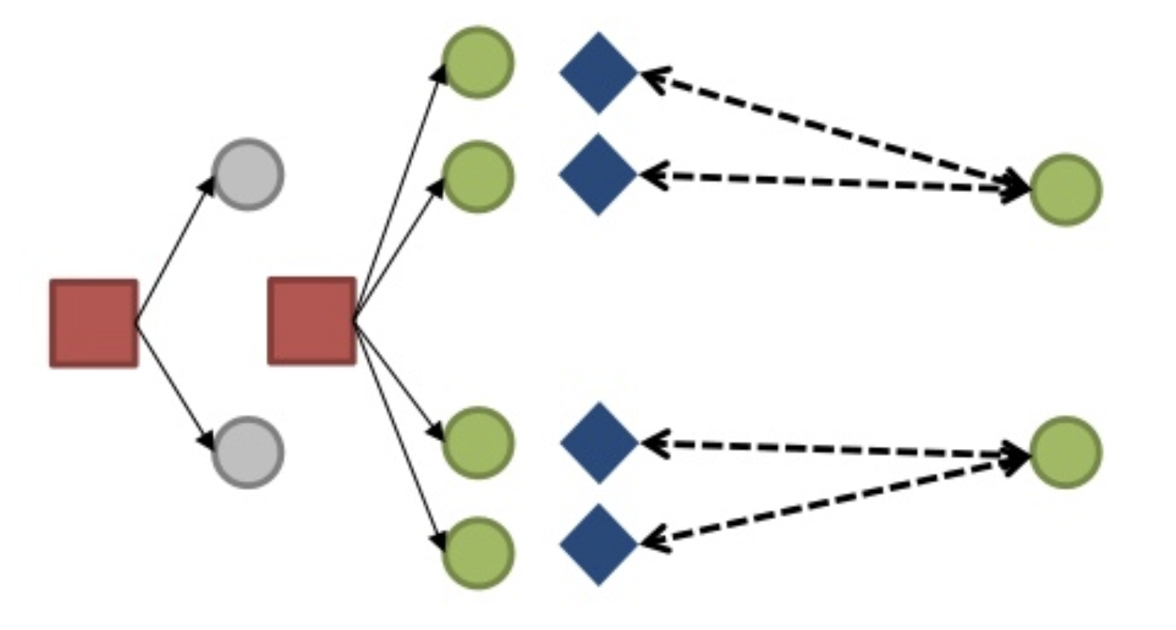
Pre-Scheduling
https://www.slideshare.net/SparkSummit/drizzlelow-latency-execution-for-apache-spark-spark-summit-east-talk-by-shivaram-venkataraman
Notes:
So in pre-scheduling, with our previous example, if we had two reduce tasks like in the previous one, they first launch the reduced tasks on the cluster. After that, we then launched the map tasks that are actually going to produce the data. When these reduce tasks are launched, they are sort of like zombie state where they are just waiting for the input, and they're not actively running right now. Once their inputs are ready, we can then trigger their execution and start doing these data transfers. So at a high level, what happens here is that we pre schedule these downstream or reduce tasks on executed, and we trigger these tasks once their input dependency are met.
Driver assigns tasks in all stages to workers, and tells each task where to send output.
When tasks complete, they notify output locations that data is ready.
asynchronously notify driver they have completed (not shown)
Tasks in next stage begin fetching input data

Slide 60
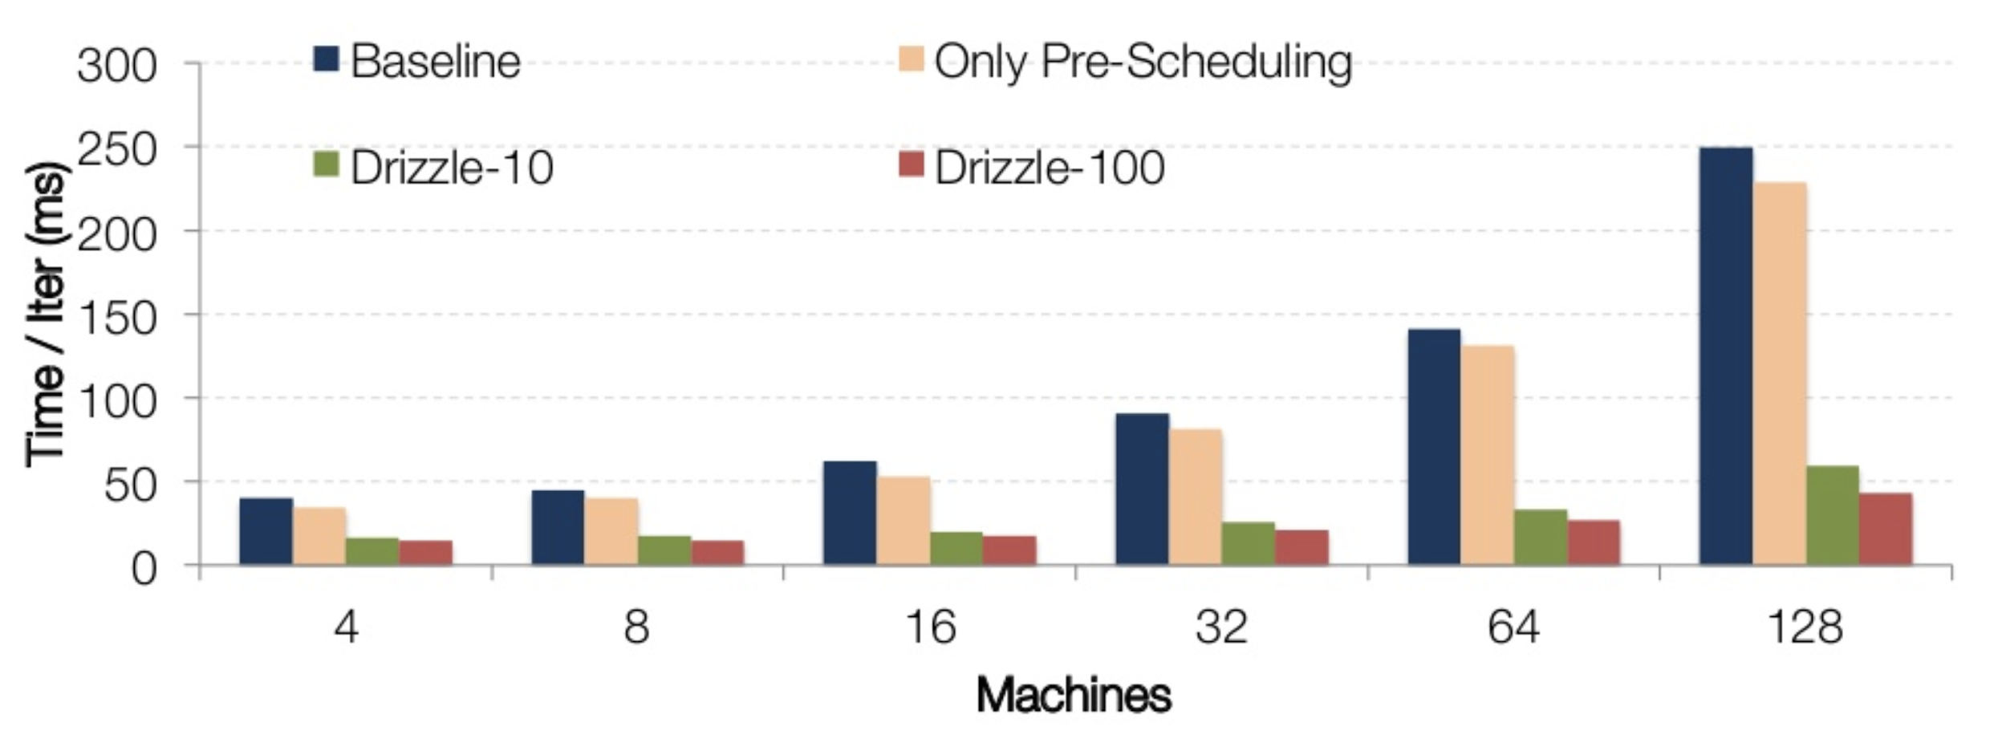
Break Down of Group Scheduling and Pre-Scheduling
https://www.slideshare.net/SparkSummit/drizzlelow-latency-execution-for-apache-spark-spark-summit-east-talk-by-shivaram-venkataraman
Notes:
So how much does this help. So this is a similar micro benchmark run before, except we are also doing a shuffle in this micro benchmark now, and the baseline here is Apache Spark. And again, this takes it on 250 milliseconds or so when done up to 128 machines. Now we also experimented with just adding, only pre-scheduling, like not doing group scheduling in this case. And that gives you some limited benefit like it usually around like 20 milliseconds benefits. But it's in combining these two techniques that were actually able to get the most out of it. So when we combine these two techniques, for the group size, let's say, 100 were able to process this boosting job with a shuffle in less than, 15 milliseconds, even at 128 machines.

Slide 61
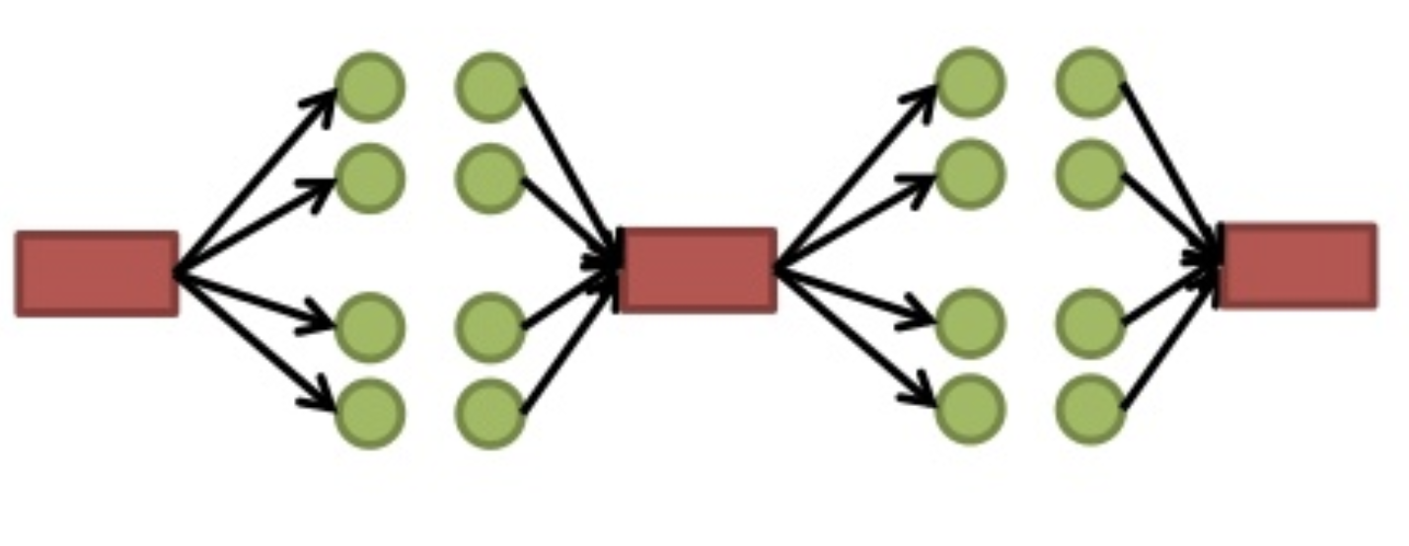
Group Scheduling Tradeoffs
Group = 1 → Batch Processing (high overhead, smaller window for fault tolerant)
Group = N → Continuous Operating (low overhead, larger window for fault tolerant)
https://www.slideshare.net/SparkSummit/drizzlelow-latency-execution-for-apache-spark-spark-summit-east-talk-by-shivaram-venkataraman
Notes:
Further on, we will then talk more about selecting group size and how some integrations can be done for optimization. We can see that, if we set the group size to 1, then we get back to batch processing. if we choose group size to infinity, then it is like Computing operating system. So by setting this group size in the middle, we sort of getting a hybrid architecture which is in between these two extremes., There are trade offs on these two extremes. One extreme we have very high overhead for execution but there's a small window for fault tolerance, and on the other hand we have low overhead, but a large window for fault tolerance. So to balance this, selecting appropriate groups size becomes an important problem, and we looking at some techniques where we can automate this so the user doesn't need to go and select this group size.

Slide 62
Group Scheduling Auto-Tuning
Smallest group such that overhead is between fixed threshold.
Overhead = T_scheduling / T_overall
If overhead > threshold, multiplicatively increase group size.
If overhead < threshold, additively decrease group size.
Similar to AIMD in TCP congestion control.
https://www.slideshare.net/SparkSummit/drizzlelow-latency-execution-for-apache-spark-spark-summit-east-talk-by-shivaram-venkataraman
Notes:
we have this tuning algorithm, which measure the scheduling overhead, and the execution time, by group that is executed. And then based on whether the scheduling overhead is too high or too low, it can actively make some changes. So for example if we set a threshold, like, let's say if I want my overhead to be within 10% of the overall execution. Then if our overhead is greater than the threshold, we can increase the group size. If the overhead is less than the threshold, we can actually decrease the group size.

Slide 63
Data-plane Optimization
Optimization within a batch
Using vectorized operations on CPUs
minimizing network traffic from partial merge operations.
Optimization across batches and queries
Metrics are aggregated at the end of a group and passed on to a query optimizer to determine if there is a better query plan.
Notes:
Also there are some optimation that can be done, within a batch or across batches and queries. For optimization within a batch, batching the computation of aggregates can provide significant performance benefit. These benefits come from using vectorized operations on CPUs or minimizing network traffic from partial merge operations. On the other hand, for optimization across batches, Metrics are aggregated at the end of a group and passed on to a query optimizer to determine if there is a better query plan.

Slide 64
Evaluation
Yahoo! Streaming Benchmark
Experiments
Latency
Throughput
Fault tolerance
Compare between Drizzle, Flink, and Spark
Run on Amazon EC2 r3.xlarge instances
Notes:
To begin with, a quick description of the benchmark. the yahoo streaming benchmark was built to compare a number of stream processing engines and the number of events that simulates on these machines that are coming across all of the machines. It mimics running analytics on a stream of ad-impressions. A producer inserts JSON records into a stream. The benchmark then groups events into 10-second windows per ad-campaign and measures how long it takes for all events in the window to be processed after the window has ended. For example if a window ended at time A and the last event from the window was processed at time B, the processing latency for this window is said to be B-A

Slide 65
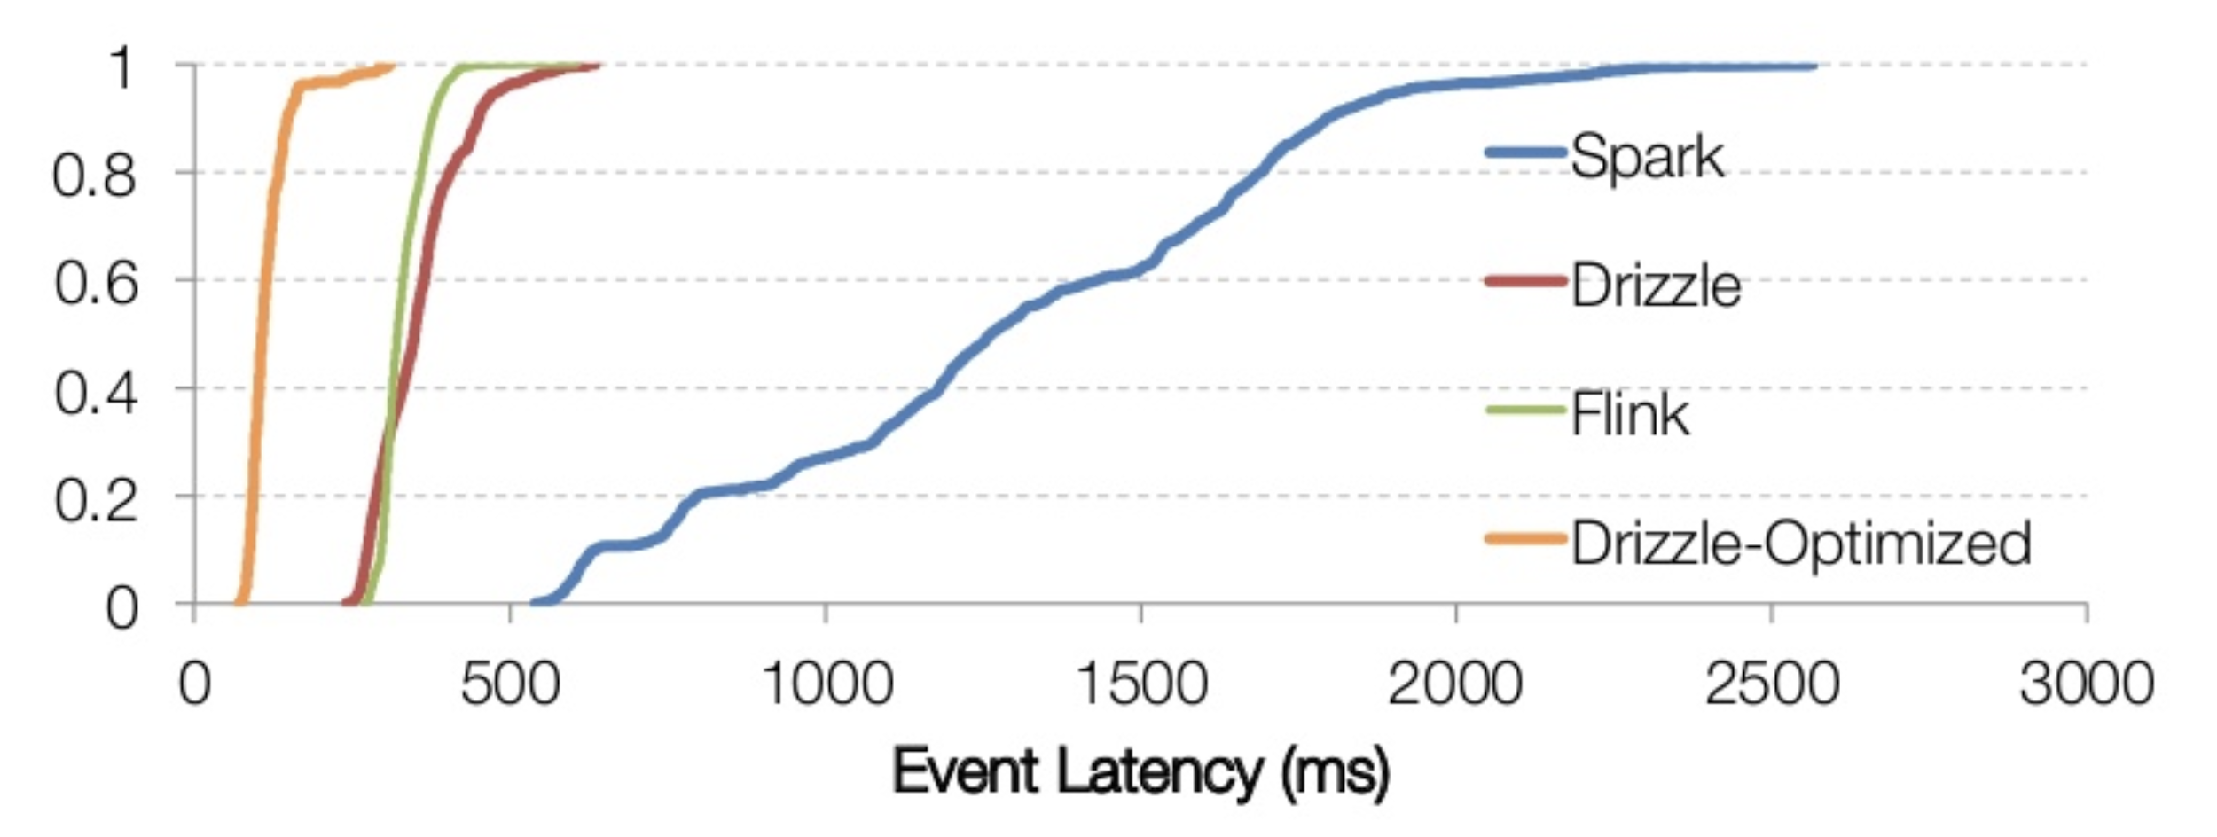
Streaming Benchmark - Latency
20M events / second on 128 machines.
Event Latency: Difference between process end and window end.
Optimized execution of each micro-batch by pushing down aggregation
https://www.slideshare.net/SparkSummit/drizzlelow-latency-execution-for-apache-spark-spark-summit-east-talk-by-shivaram-venkataraman
Notes:
In the Yahoo Streaming benchmark, as the output only requires the number of events in a window we can reduce the amount of data shuffled by aggregating counters for each window on the map side.

Slide 66
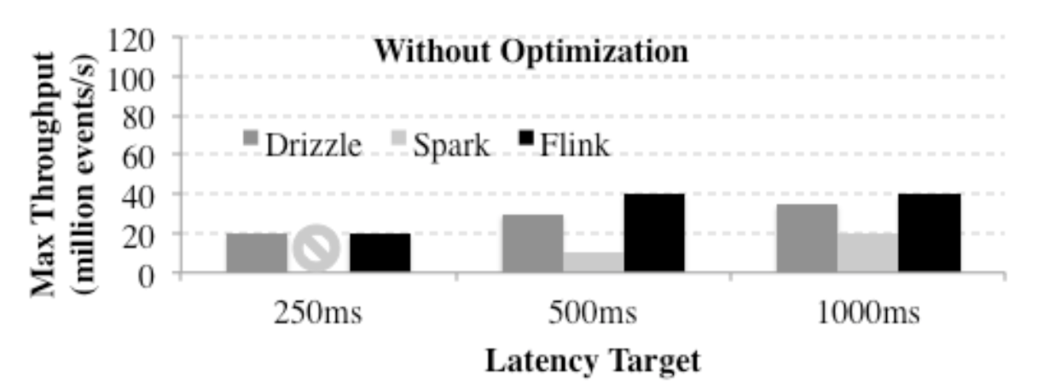
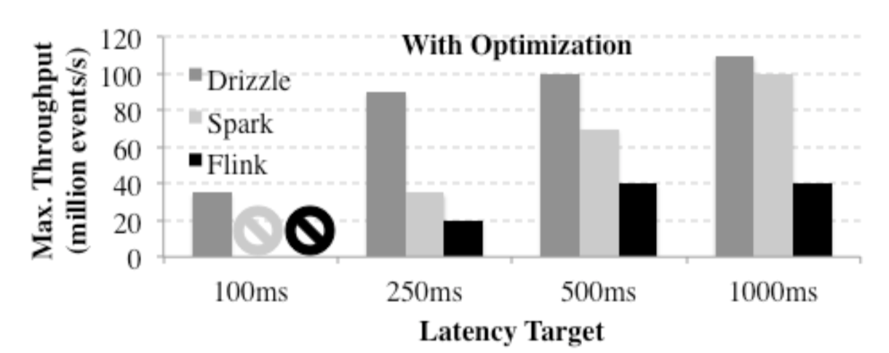
Streaming Benchmark - Throughput
Notes:
We next compare the maximum throughput that can be achieved given a latency target.
This is because the overheads from scheduling become less important at higher latency targets and thus the benefits from Drizzle become less relevant.

Slide 67
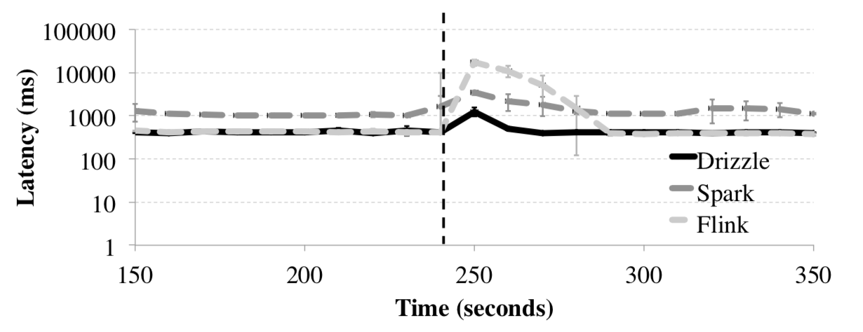
Streaming Benchmark - Fault Tolerance
Inject machine failure at 240 second.
Notes:
So that's in terms of performance. What about in terms of fault tolerance. With the same benchmark, the thing that is done here is we killed one of the machines at the four minute mark, which is 240 second line out here. And we try to measure how long it takes for the system to recover to the original crossing state.
We see that using the micro-batch model in Spark has good relative adaptivity where the latency during failure is around 3x normal processing latency and that only 1 window is affected. Drizzle has similar behavior where the latency during failure increases from around 350ms to around 1s. Similar to Spark, Drizzle’s latency also returns to normal after one window.
On the other hand Flink experiences severe slowdown during failure and the latency spikes to around 18s. Most of this slow down is due to the additional coordination required to stop and restart all the operators in the topology and to restore execution from the latest checkpoint.

Slide 68
Conclusion
Drizzle: Decouple execution from centralized scheduling.
Achieve low latency, high throughput with adaptability.
Amortized overheads using group scheduling and pre-scheduling.

Slide 69
Discussion
Is there a way to determine scheduling efficiency (group size) automatically?
Why Drizzle has better fault tolerant shown in the figure?

Slide 71
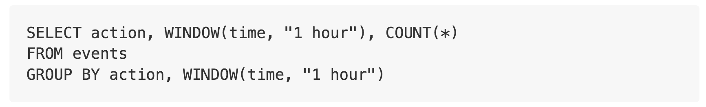
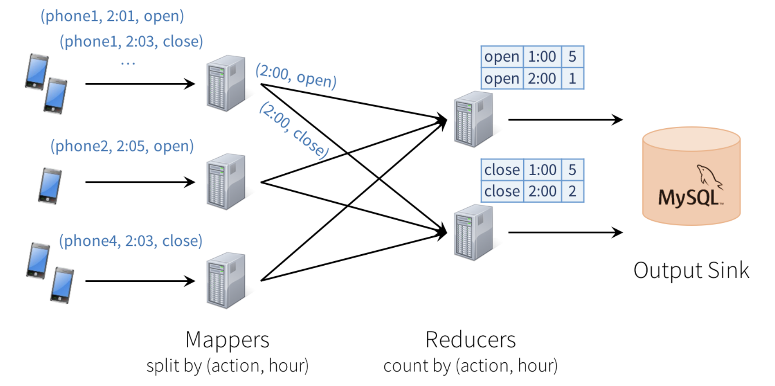
Prefix Integrity

Slide 72
Challenges
Consistency: This distributed design can cause records to be processed in one part of the system before they’re processed in another, leading to nonsensical results. For example, suppose our app sends an “open” event when users open it, and a “close” event when closed. If the reducer node responsible for “open” is slower than the one for “close”, we might see a higher total count of “closes” than “opens” in MySQL, which would not make sense. The image above actually shows one such example.
Fault tolerance: What happens if one of the mappers or reducers fails? A reducer should not count an action in MySQL twice, but should somehow know how to request old data from the mappers when it comes up. Streaming engines go through a great deal of trouble to provide strong semantics here, at least within the engine. In many engines, however, keeping the result consistent in external storage is left to the user.
Out-of-order data: In the real world, data from different sources can come out of order: for example, a phone might upload its data hours late if it’s out of coverage. Just writing the reducer operators to assume data arrives in order of time fields will not work—they need to be prepared to receive out-of-order data, and to update the results in MySQL accordingly.

Slide 73
Prefix Integrity
At any time, the output of the application is equivalent to executing a batch job on a prefix of the data.
Output tables are always consistent with all the records in a prefix of the data. For example, as long as each phone uploads its data as a sequential stream (e.g., to the same partition in Apache Kafka), we will always process and count its events in order.
Fault tolerance is handled holistically by Structured Streaming, including in interactions with output sinks. This was a major goal in supporting continuous applications.
The effect of out-of-order data is clear. We know that the job outputs counts grouped by action and time for a prefix of the stream. If we later receive more data, we might see a time field for an hour in the past, and we will simply update its respective row in MySQL. Structured Streaming also supports APIs for filtering out overly old data if the user wants. But fundamentally, out-of-order data is not a “special case”: the query says to group by time field, and seeing an old time is no different than seeing a repeated action.

Slide 75
Observation
Existing solutions require operators to choose between achieving low latency during normal operation and incurring minimal impact during adaptation.
Continuous operator streaming: Naiad, Flink
Micro-batch system: Spark streaming, FlumeJava
While streaming workloads require millisecond-level processing, workload and cluster properties change less frequently.

